Slide 1
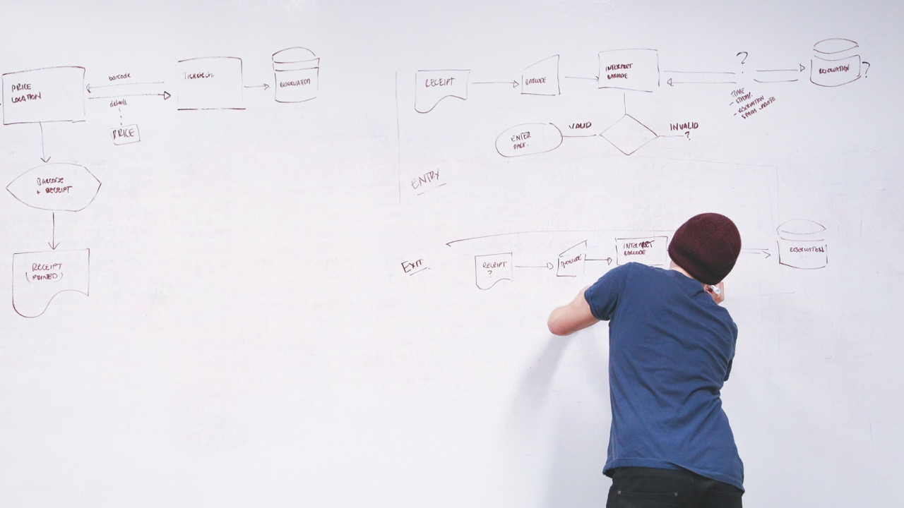

Team 9: Data Mining
Jiemin Huang
Yinchen Li
Hongdi Zhang
Xian Zhang
Lan Zou

Notes:
Good Afternoon, Ladies and Gentlemen, I am Jay. On behalf of Team 5, here I am presenting our project design to you.

Slide 2
Agenda




Business
Scenarios
Decision
Tree
Lessons
Learned
KNN
01
02
03
04

Slide 3
Business scenario
Historical data
New customers: recommend new product
$56M
$34M
$32M
$21M
New product: predict prospect

Slide 4
KNN (K-Nearest Neighbors)
Data preparation
Build initial model
Cross validation
Model training
Predict

Slide 5
KNN: Model training
Get best weights for similarity formula

Slide 6
Decision Tree
Data preparation
Generate initial tree
Cross validation
Optimization
Predict

Slide 7
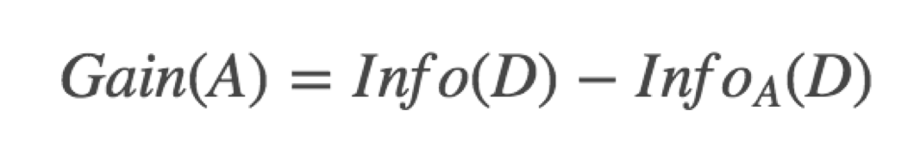
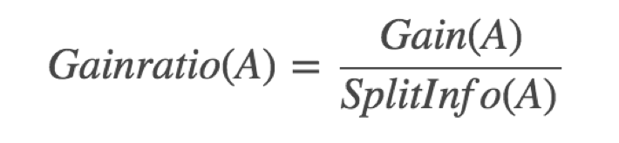
Decision Tree: Optimization (overfitting problem)
Protect overfitting: ID3 -> C4.5
Penalize attributes with lots of tiny subsets.
overfitting

Slide 8
Results comparison
 | Weka | KNN | Decision Tree
Part A | Default: 84.54% Optimal: 86.56% |  | 86.10%
Part B | Default: 95.62% Optimal: 96.25% |  | 95.63%

Slide 9
Lessons learned 1: Pros and Cons
 | KNN | DT
pros | Linear training time complexity Insensitive to outliers Works for classification & regression | White box, explainable No data normalization Low time complexity in prediction
cons | Black box, less explainable High time complexity in prediction Lazy learning | Not good at handling missing data Overfitting problem Only works for classification

Slide 10
Lessons learned 2: How to pick right Algorithm?
KNN | DT
Classification, regression | classification
Small-medium dataset | Large dataset
Train model each time | Established model

Slide 11

Lessons learned 3: Dos and don’ts
Dos
Normalize input data (KNN)
Randomize training data
Weighted similarity (KNN)
Weighted voting (KNN)
Protect overfitting (DT)
Don’ts
Input missing data
Global attribute optimization (KNN)

Slide 12
Thanks

